Slide 1
Introduction to Programming in Python
Python Fundamentals

Slide 2
Introduction
What is Python Programming?
Environment Setup
Variables and Assignment Operators

Slide 3
Introduction
Who is this course for?
People of any age with or without prior programming experience
What can you expect to learn?
Basic Programming concepts: Functions, Inheritance, Class, Object, Data Structures and more
Techniques to approach problems using Computer Programs
Why python?
Python is the world’s most popular programming language
Easier to learn, works on different platforms (Windows, Mac, Linux, etc.)
Open source, free and widely available with a massive open-source community
Extensive standard libraries
Used in Mobile App, Web Dev, AI, Big Data, Data Science, Game Programming,….
Python is a great language to learn, so let’s get started!
Notes:
your programs will do more in fewer lines of code than many other languages would require

Slide 4
What’s Python Programming?
Python is a popular programming language. It was created in 1991 by Guido van Rossum.
It’s used for Web Development Data Science and Machine Learning Game Development Application Development Internet of Things (IoT) Statistics and much more.

Slide 5
Setting up Python Environment
How to get python running on your system? Python programming is platform independent (write the code once, it should run almost on all supported platforms). “Write once, run anywhere”
Interpreted programming language
How to run python?
There are various ways to run python scripts but the preferred way is withing an IDE
Python’s standard distribution includes IDLE as the default IDE
Follow the steps in the next slides to install Python-IDLE
Notes:
Python is also a piece of software called an interpreter. The interpreter is the program you’ll need to run Python code and scripts. Technically, the interpreter is a layer of software that works between your program and your computer hardware to get your code running.

Slide 6
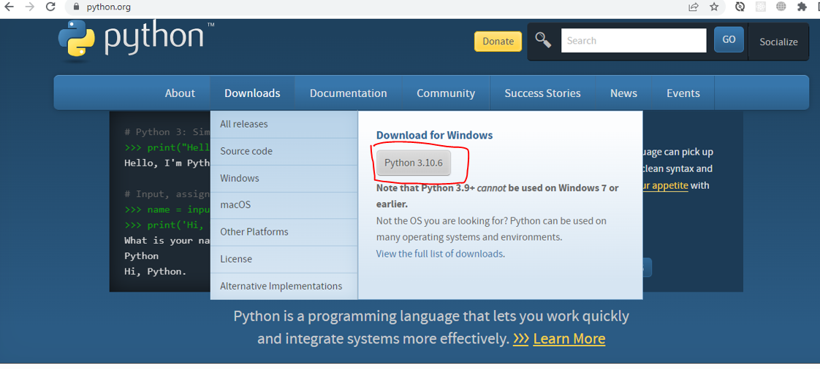
Python-IDLE installation
Open website https://www.python.org/ from your web browser. Click at Downloads. Different options will be shown. You can choose the version you want to download as per your operating system.

Slide 7
Installation contd.
Double click at Python installer downloaded on your computer. And follow the wizard installation steps.
Click the Run button to continue installation → make sure to check “Add Python 3.xx to Path” box
Click at Install Now

Slide 8
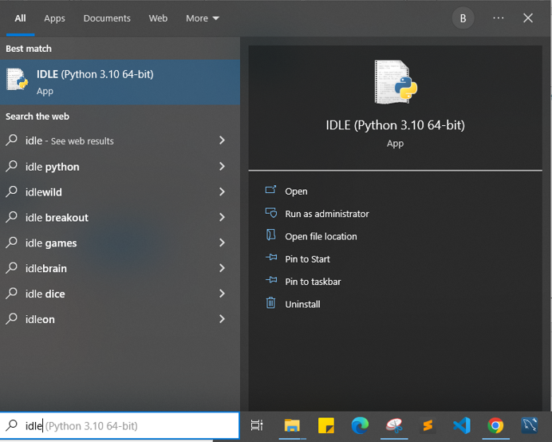
How to use Python IDLE
To start the IDLE interactive shell, search for the IDLE icon in the start menu and double click on it.

Slide 9
Two modes of Python IDLE
Interactive mode (Shell, terminal, command line)
Hint Enter to display result
Script mode (Editor)
press F5 to run the script in the editor window

Slide 10
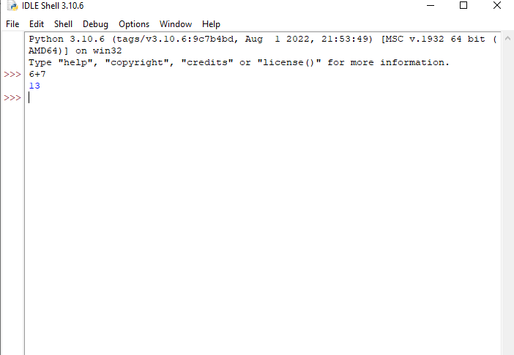
The following python shell will be opened (Interactive mode)
.

Slide 11
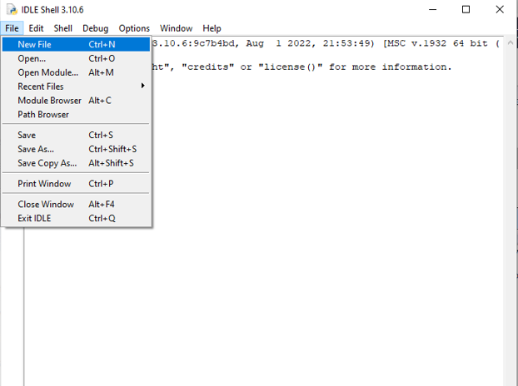
To Execute a python script(code)
Create a new file by selecting File -> New File from the menu.

Slide 12
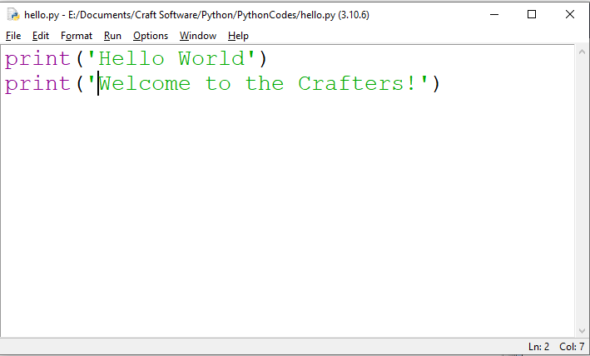
Script mode
Enter multiple statements and save the file with extension .py using File -> Save. For example, save the following code as hello.py. press F5 to run the script in the editor window

Slide 13
Now you’re good to go coding python!
Happy Coding!

Slide 14
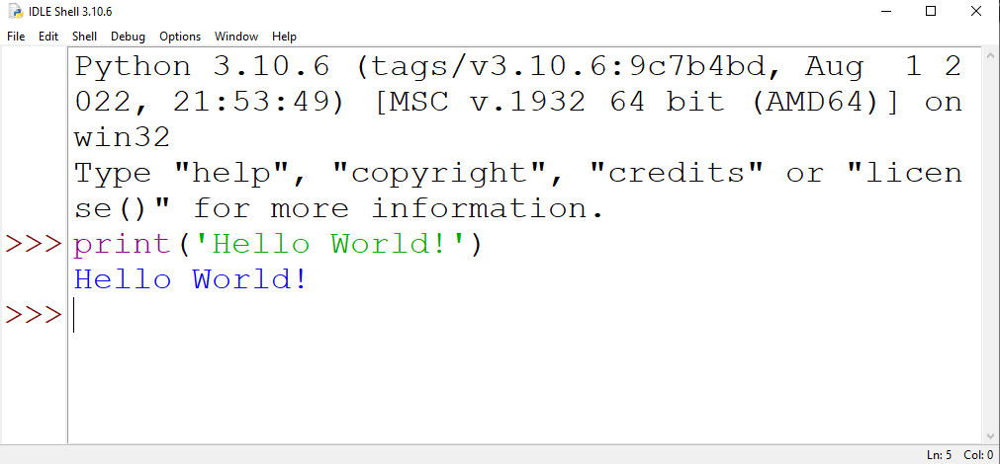
Our First Program – Hello World (Method 1 – using Shell Mode)
>>>print("Hello World!")
Output → Hello World!
Notes:
Congratulations, you have written and executed your first Python program.

Slide 15
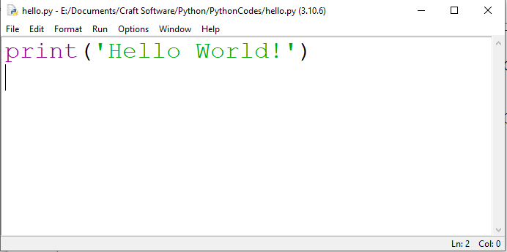
Our First Program – Hello World (Method 2 -- using Script Mode)
Creating a python file on the editor, using the .py file extension

Slide 16
Python Operators (Practice on the Shell)
>>>print(10 + 5)
>>>print(10 - 5)
>>>print(10 * 5)
>>>print(10 / 5)
Arithmetic operators Addition X + Y Subtraction X – Y Multiplication X * Y (asterisk) Division X / Y (True Division) Modulus X % Y (Remainder) Exponentiation X ** Y (Power) Floor Division X // Y
Notes:
Arithmetic operators are used with numeric values to perform common mathematical operations:

Slide 17
True Division Vs. Floor Division
>>>print(7 / 4)
OUTPUT: 1.75
True division (/) divides a numerator by a denominator and yields a floating-point number with a decimal point.
>>>print(7 // 4)
OUTPUT: 1
Floor division (//) divides a numerator by a denominator, yielding the highest integer that’s not greater than the result. Python truncates (discards) the fractional part:
What would be the output of the following statement?
>>>print(7 / 0)
Notes:
ZeroDivisionError

Slide 18
Remainder Operator (%)
Python’s remainder operator (%) yields the remainder after the left operand is divided by the right operand: Example >>>print(7 % 4) OUTPUT: 3 In this case, 7 divided by 4 yields a quotient of 1 and a remainder of 3.

Slide 19
Operator Precedence
>>> 2 + 3 * 3
OUTPUT: 11
>>> (2 + 3) * 3
OUTPUT: 15
>>> 1 + 2 ** 2
OUTPUT: 5
>>> 2 / 2 * 8
OUTPUT: 8.0
Order of Operation: PEMDAS : Parenthesis, Exponentiation, (Multiplication, Division, Modulus), (Addition, Subtraction)

Slide 20
Variables and Assignments
Variables are used to temporarily store data in a computer's memory
Variables are containers for storing data values
price = 10
print(price)
output: 10
Here price is an identifier/variable and 10 is the value
Storing a value into a variable is called a variable assignment.

Slide 21
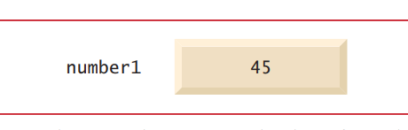
Variables
number1 = 45
Variable names such as number1 and price actually correspond to locations in the computer's memory. Every variable has a name, a type, a size (in bytes) and a value. The Computer places 45 into location number1

Slide 22
variables
A variable name must start with a letter or the underscore character
A variable name cannot start with a number
A variable name can only contain alpha-numeric characters and underscores (A-z, 0-9, and _ )
Variable names are case-sensitive (age, Age and AGE are three different variables)

Slide 23
Assignment Operator
An equal sign ( = ) is the assignment operator
sumOfNumbers = 4 + 5
MyVariableName = ”John”
The right side of the = symbol always executes first, then the result is assigned to the variable on the symbol’s left side

Slide 24
Challenge 1
Suppose you have $100, which you can invest with a 10% return each year. After one year, it’s 100 * 1.1 = 110 dollars, and after two years it’s 110 * 1.1 * 1.1 = 121 . Add code to calculate how much money you end up with after 7 years, and print the result. HINT: Use Multiplication and exponentiation operators only

Slide 25
Challenge 2
Calculate your body mass index (BMI) HINT: BMI = Weight / (Height ** Height) Weight is in Kg. and Height is in Meter.

Slide 26
Challenge 3
Given the three sides of a triangle a, b and c as: a = 5 b = 6 c = 7
Print the area of the triangle: Hint: Area of triangle = (a + b + c) / 2

Slide 27
Challenge 4
What is the output of: >>>print(10 – 4 * 2) >>>print(-18 // 4) >>>print(2 * 3 ** 3 * 4) >>>print(2 % 6) >>>a = b = c = 5
>>>sum = a + b + c
>>>print(sum)
>>>print(a)
>>>print(b)
>>>print(c)
How do you know the version of Python you’re using? >>>import sys >>>sys.version OR in the command line(cmd) run the command: python --version

Slide 28
Challenge 3 Solution
>>>a = 5
>>>b = 6
>>>c = 7
>>>area = (a + b + c) / 2
>>>print(area)
Congrats! You’ve written a code that calculates the area of a triangle!

Slide 29
https://python.land/introduction-to-python
https://www.learnpython.org/en/Variables_and_Types
https://www.w3schools.com/python/default.asp

